Slide 1
Process/Thread Scheduling

Slide 2
Basic Concepts
Maximum CPU utilization obtained with multiprogramming
CPU–I/O Burst Cycle – Process execution consists of a cycle of CPU execution and I/O wait
CPU burst followed by I/O burst
CPU burst distribution is of main concern

Slide 3
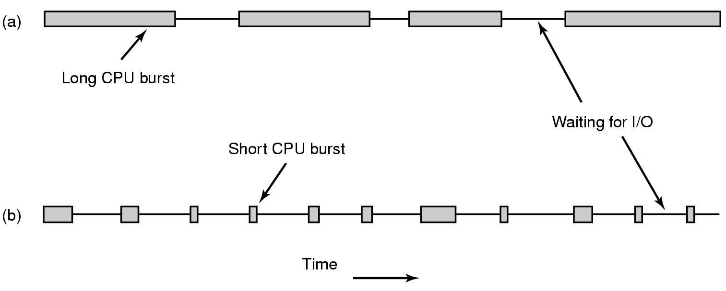
Scheduling – Process Behavior
Bursts of CPU usage alternate with periods of waiting for I/O. (a) A CPU-bound process. (b) An I/O-bound process.
Tanenbaum, Modern Operating Systems 3 e, (c) 2008 Prentice-Hall, Inc. All rights reserved. 0-13-6006639

Slide 4
When to make scheduling decisions
New process creation (run parent or child)
Schedule when
A process exits
A process blocks (e.g. on a semaphore)
I/O interrupt happens
Tanenbaum, Modern Operating Systems 3 e, (c) 2008 Prentice-Hall, Inc. All rights reserved. 0-13-6006639

Slide 5
Categories of Scheduling Algorithms
Batch (accounts receivable, payroll…..)
Interactive
Real time (deadlines)
Depends on the use to which the CPU is being put
Tanenbaum, Modern Operating Systems 3 e, (c) 2008 Prentice-Hall, Inc. All rights reserved. 0-13-6006639

Slide 6
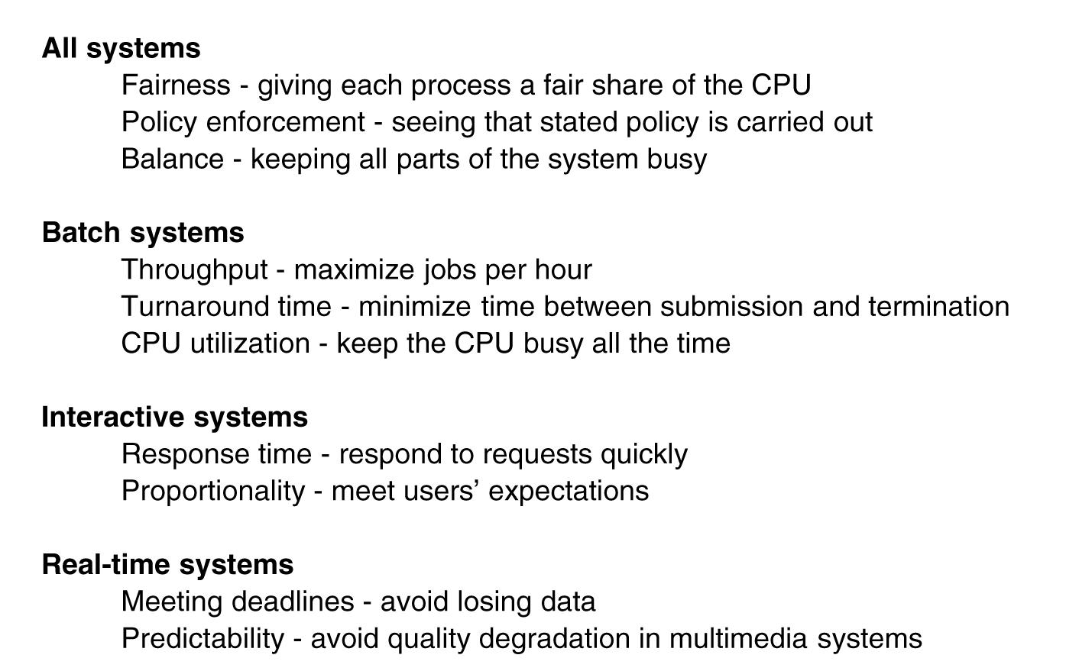
Scheduling Algorithm Goals
Tanenbaum, Modern Operating Systems 3 e, (c) 2008 Prentice-Hall, Inc. All rights reserved. 0-13-6006639

Slide 7
CPU Scheduler
Short-term scheduler selects from among the processes in ready queue, and allocates the CPU to one of them
Queue may be ordered in various ways
CPU scheduling decisions may take place when a process:
Switches from running to waiting state
Switches from running to ready state
Switches from waiting to ready
Terminates
Scheduling under 1 and 4 is nonpreemptive
All other scheduling is preemptive
Consider access to shared data
Consider preemption while in kernel mode
Consider interrupts occurring during crucial OS activities

Slide 8
Dispatcher
Dispatcher module gives control of the CPU to the process selected by the short-term scheduler; this involves:
switching context
switching to user mode
jumping to the proper location in the user program to restart that program
Dispatch latency – time it takes for the dispatcher to stop one process and start another running

Slide 9
Scheduling Criteria
CPU utilization – keep the CPU as busy as possible
Throughput – number of processes that complete their execution per time unit
Turnaround time – amount of time to execute a particular process
Waiting time – amount of time a process has been waiting in the ready queue
Response time – amount of time it takes from when a request was submitted until the first response is produced, not output (for time-sharing environment)

Slide 10
Scheduling Algorithm Optimization Criteria
Max CPU utilization
Max throughput
Min turnaround time
Min waiting time
Min response time

Slide 11
First- Come, First-Served (FCFS) Scheduling
Process Burst Time
P₁ 24
P₂ 3
P₃ 3
Suppose that the processes arrive in the order: P₁ , P₂ , P₃
The Gantt Chart for the schedule is:
Waiting time for P₁ = 0; P₂ = 24; P₃ = 27
Average waiting time: (0 + 24 + 27)/3 = 17

Slide 12
FCFS Scheduling (Contd.)
Suppose that the processes arrive in the order:
P₂ , P₃ , P₁
The Gantt chart for the schedule is:
Waiting time for P₁ = 6; P₂ = 0; P₃ = 3
Average waiting time: (6 + 0 + 3)/3 = 3
Much better than previous case
Convoy effect - short process behind long process
Consider one CPU-bound and many I/O-bound processes

Slide 13
Shortest-Job-First (SJF) Scheduling
Associate with each process the length of its next CPU burst
Use these lengths to schedule the process with the shortest time
SJF is optimal – gives minimum average waiting time for a given set of processes
The difficulty is knowing the length of the next CPU request
Could ask the user

Slide 14
Example of SJF
Process Arrival Time Burst Time
P₁ 0.0 6
P₂ 2.0 8
P₃ 4.0 7
P₄ 5.0 3
SJF scheduling chart
Average waiting time = (3 + 16 + 9 + 0) / 4 = 7

Slide 15
Determining Length of Next CPU Burst
Can only estimate the length – should be similar to the previous one
Then pick process with shortest predicted next CPU burst
Can be done by using the length of previous CPU bursts, using exponential averaging
Commonly, α set to ½

Slide 16
Prediction of Length of the Next CPU Burst

Slide 17
Examples of Exponential Averaging
α =0
τ_{n+1} = τ_{n}
Recent history does not count
α =1
τ_{n+1} = α t_{n}
Only the actual last CPU burst counts
If we expand the formula, we get:
τ_{n+1} = α t_{n}+(1 - α)α t_{n} ₋₁ + …
+(1 - α )^{j} α t_{n} _{-j} + …
+(1 - α )^{n +1} τ₀
Since both α and (1 - α) are less than or equal to 1, each successive term has less weight than its predecessor

Slide 18
SRTF
The SJF algorithm can be either preemptive or non-preemptive.
The choice arises when a new process arrives at the ready queue while a previous process is still executing.
The next CPU burst of the newly arrived process may be shorter than what is left of the currently executing process.
A preemptive SJF algorithm will preempt the currently executing process, whereas a non-preemptive SJF algorithm will allow the currently running process to finish its CPU burst.
Preemptive SJF scheduling is sometimes called shortest-remaining-time-first scheduling.

Slide 19
Example SRTF
Now we add the concepts of varying arrival times and preemption to the analysis
Process Arrival Time T Burst Time
P₁ 0 8
P₂ 1 4
P₃ 2 9
P₄ 3 5
Preemptive SJF Gantt Chart
Average waiting time = [(10-1)+(1-1)+(17-2)+(5-3)]/4 = 26/4 = 6.5 msec

Slide 20
Priority Scheduling
An SJF algorithm is a priority algorithm where the priority (p) is the inverse of the (predicted) next CPU burst.
The larger the CPU burst, the lower the priority, and vice versa.
A priority number (integer) is associated with each process

Slide 21
Priority Scheduling
The CPU is allocated to the process with the highest priority (Assume smallest integer ≡ highest priority)
Preemptive
Nonpreemptive
A preemptive priority scheduling algorithm will preempt the CPU if the priority of the newly arrived process is higher than the priority of the currently running process.
A non- preemptive priority scheduling algorithm will simply put the new process at the head of the ready queue.
Problem ≡ Starvation – low priority processes may never execute
Solution ≡ Aging – as time progresses increase the priority of the process

Slide 22

Example of Priority Scheduling
Process Burst Time Priority
P₁ 10 3
P₂ 1 1
P₃ 2 4
P₄ 1 5
P₅ 5 2
Priority scheduling Gantt Chart
Average waiting time = 8.2 msec

Slide 23
Round Robin (RR) Scheduling
Each process gets a small unit of CPU time (time quantum, q), usually 10-100 milliseconds.
After this time has elapsed, the process is preempted and added to the end of the ready queue (circular queue).
If there are n processes in the ready queue and the time quantum is q, then each process gets 1/n of the CPU time in chunks of at most q time units at once.
No process waits more than (n-1)q time units.
Timer interrupts every quantum to schedule next process

Slide 24
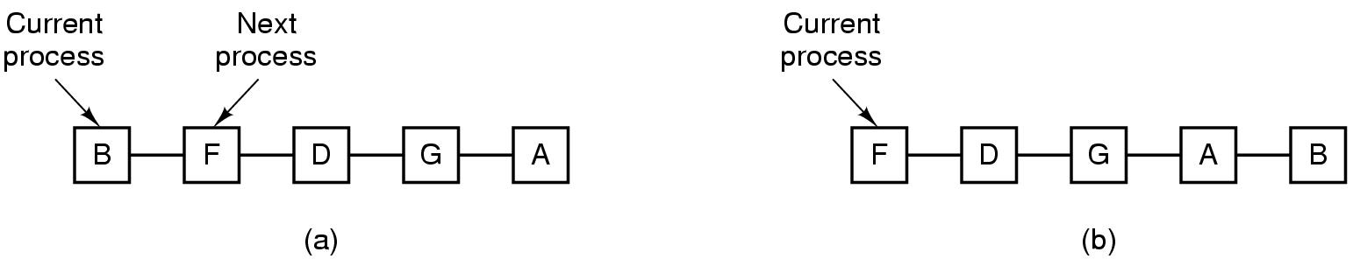
Round-Robin Scheduling
Process list-before and after
Tanenbaum, Modern Operating Systems 3 e, (c) 2008 Prentice-Hall, Inc. All rights reserved. 0-13-6006639

Slide 25
Round Robin Scheduling
A preemptive priority scheduling algorithm will preempt the CPU if the priority of the newly arrived process is higher than the priority of the currently running process.
A non-preemptive priority scheduling algorithm will put the new process at the head of the ready queue.

Slide 26
Round Robin Scheduling
Quantum too short => too many process switches
Quantum too long => wasted cpu time
20-50 msec seems to be OK
Performance
q large ⇒ FIFO
q small ⇒ q must be large with respect to context switch, otherwise overhead is too high
For example, with five processes and a time quantum of 20 milliseconds, each process will get up to 20 milliseconds every 100 milliseconds
Don’t need to know run times in advance

Slide 27
Example of RR with Time Quantum = 4
Process Burst Time
P₁ 24
P₂ 3
P₃ 3
The Gantt chart is:
Typically, higher average turnaround than SJF, but better response
q should be large compared to context switch time
q usually 10ms to 100ms, context switch < 10 microsec

Slide 28
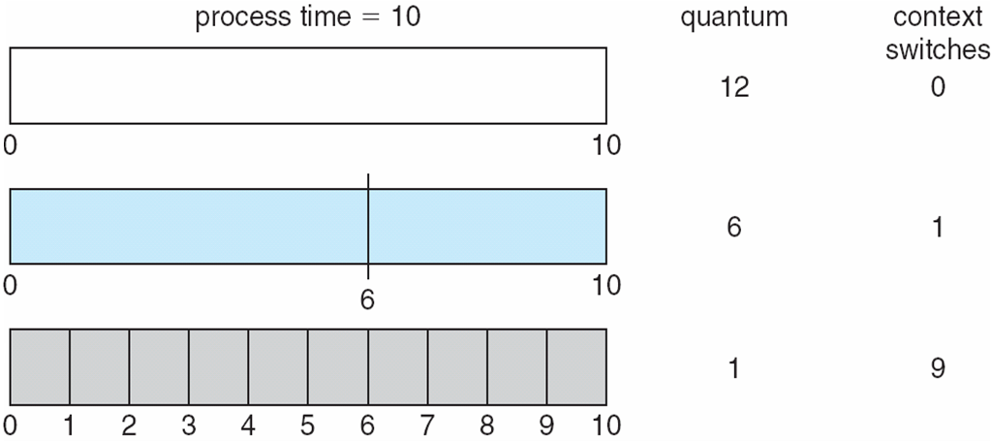
Time Quantum & Context Switch Time

Slide 29
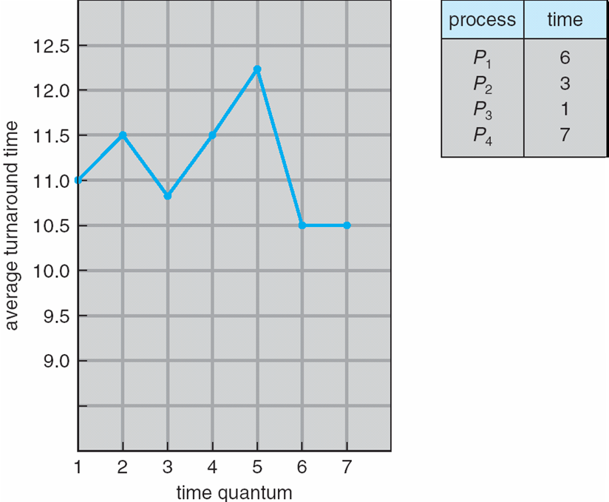
Turnaround Time Varies With The Time Quantum
80% of CPU bursts should be shorter than q

Slide 30
Multilevel Queue
Ready queue is partitioned into separate queues
foreground (interactive), background (batch)
Process permanently in a given queue
Each queue has its own scheduling algorithm:
foreground – RR
background – FCFS
Scheduling must be done between the queues:
Fixed priority scheduling; (i.e., serve all from foreground then from background). Possibility of starvation.
Time slice – each queue gets a certain amount of CPU time which it can schedule amongst its processes; i.e., 80% to foreground in RR
20% to background in FCFS

Slide 31
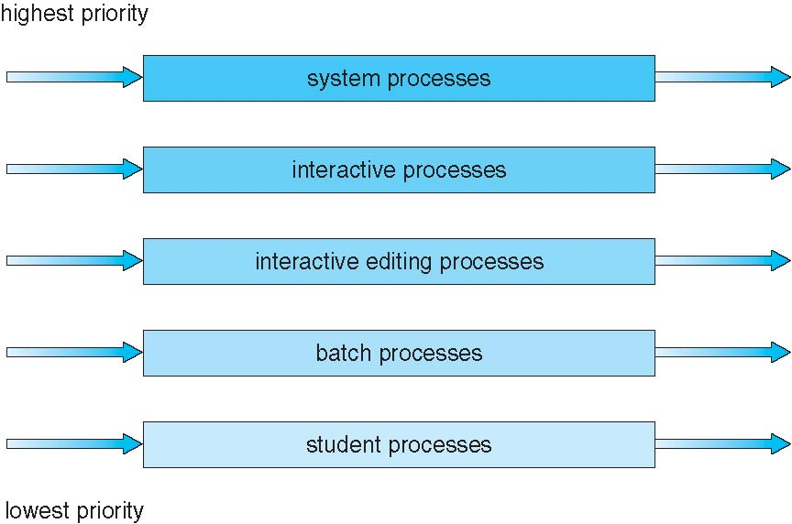
Multilevel Queue Scheduling

Slide 32
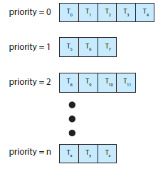
Separate Queues for Each Priority

Slide 33
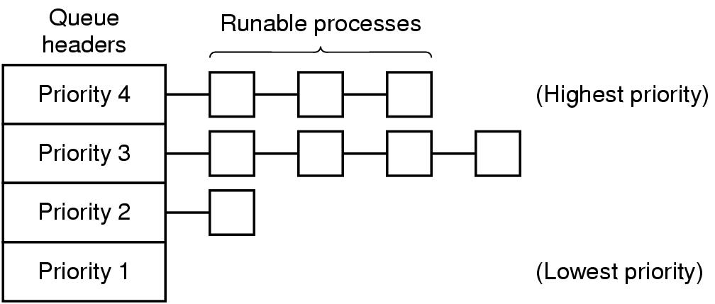
Priority Scheduling
Tanenbaum, Modern Operating Systems 3 e, (c) 2008 Prentice-Hall, Inc. All rights reserved. 0-13-6006639

Slide 34
Multiple Queues with Priority Scheduling
Highest priority gets one quantum, second highest gets 2…
If highest finishes during quantum, great. Otherwise serve second highest priority and so on
Consequently, shortest (high priority) jobs get out first

Slide 35
Multilevel Feedback Queue
A process can move between the various queues; aging can be implemented this way
Multilevel-feedback-queue scheduler defined by the following parameters:
number of queues
scheduling algorithms for each queue
method used to determine when to upgrade a process
method used to determine when to demote a process
method used to determine which queue a process will enter when that process needs service

Slide 36
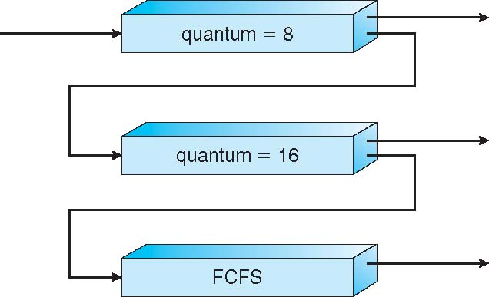
Example of Multilevel Feedback Queue
Three queues:
Q₀ – RR with time quantum 8 ms
Q₁ – RR time quantum 16 ms
Q₂ – FCFS
Scheduling
A new job enters queue Q₀ which is served FCFS
When it gains CPU, job receives 8 milliseconds
If it does not finish in 8 milliseconds, job is moved to queue Q₁
At Q₁ job is again served FCFS and receives 16 additional milliseconds
If it still does not complete, it is preempted and moved to queue Q₂

Slide 37
Threads: Motivation
Most modern applications including modern kernels are multithreaded.
A thread is a basic unit of CPU utilization; it comprises a thread ID, a program counter, a register set, and a stack.

Slide 38
Threads: Motivation
Multithreading refers to the ability of an operating system to support multiple, concurrent paths of execution within a single process.
Threads run within application.
Multiple tasks with the application can be implemented by separate threads
Update display
Fetch data
Spell checking
Answer a network request

Slide 39
Thread
Process creation is heavy-weight while thread creation is light-weight
Can simplify code, increase efficiency.
It shares with other threads belonging to the same process its code section, data section, and other operating-system resources, such as open files and signals.
A traditional (or heavyweight) process has a single thread of control.
If a process has multiple threads of control, it can perform more than one task at a time.

Slide 40
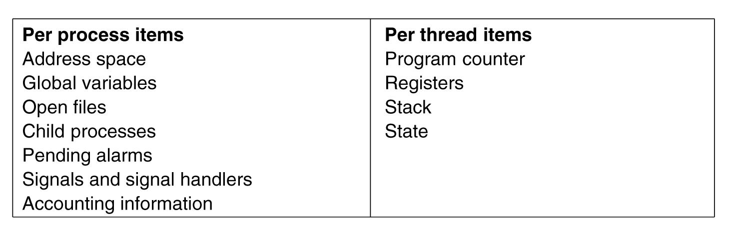
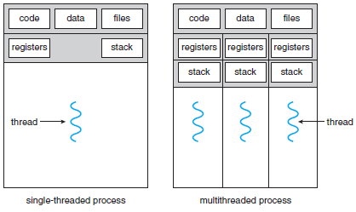
Threads are lightweight

Slide 41
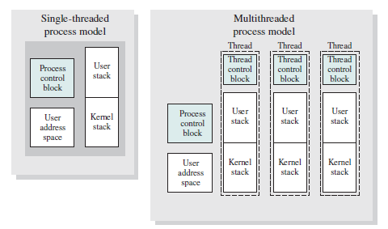
Another View

Slide 42
Key benefits of threads
It takes far less time to create a new thread in an existing process, than to create a brand-new process.
Studies done by the Mach developers show that thread creation is ten times faster than process creation in UNIX
It takes less time to terminate a thread than a process.
It takes less time to switch between two threads within the same process than to switch between processes.
Threads enhance efficiency in communication between different executing programs.
In most operating systems, communication between independent processes requires the intervention of the kernel to provide protection and the mechanisms needed for communication.
However, because threads within the same process share memory and files, they can communicate with each other without invoking the kernel.

Slide 43
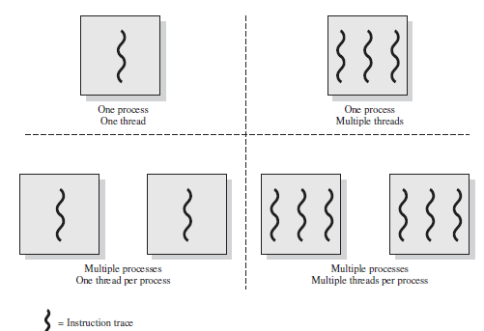
Threads and Processes
JRE is an example

Slide 44
Threads are like processes
Have same states (after spawning)
Running
Ready
Blocked
Have their own stacks –same as processes
Stacks contain frames for (un-returned) procedure calls
Local variables
Return address to use when procedure comes back
Tanenbaum, Modern Operating Systems 3 e, (c) 2008 Prentice-Hall, Inc. All rights reserved. 0-13-6006639

Slide 45
General Concept of Multithreading
In a multithreaded environment, a process is the unit of resource allocation and a unit of protection. Process has
A virtual address space that holds the process image
Protected access to processors,
other processes (for IPC), files, and
I/O resources (devices and channels)
Within a process, there may be one or more threads, each with the following:
A thread execution state (Running, Ready, etc.)
A saved thread context when not running; one way to view a thread is as an independent program counter operating within a process
An execution stack
Some per-thread static storage for local variables
Access to the memory and resources of its process, shared with all other threads in that process

Slide 46
How do threads work?
Start with one thread in a process
Thread contains (id, registers, attributes)
Use library call to create new threads and to use threads
Thread_create includes parameter indicating what procedure to run
Thread_exit causes thread to exit and disappear (can’t schedule it)
Thread_join Thread blocks until another thread finishes its work
Thread_yield

Slide 47
Multithreaded Server Architecture

Slide 48
Multicore Programming
Multicore or multiprocessor systems put pressure on programmers, challenges include:
Dividing activities
Balance
Data splitting
Data dependency
Testing and debugging
Parallelism implies a system can perform more than one task simultaneously
Concurrency supports more than one task making progress
Single processor / core, scheduler providing concurrency

Slide 49
Multicore Programming (Cont.)
Types of parallelism
Data parallelism – distributes subsets of the same data across multiple cores, same operation on each
Task parallelism – distributing threads across cores, each thread performing unique operation
As number of threads grows, so does architectural support for threading
CPUs have cores as well as hardware threads
Consider Oracle SPARC T4 with 8 cores, and 8 hardware threads per core

Slide 50
Concurrency vs. Parallelism
Concurrent execution on single-core system:
Parallelism on a multi-core system:

Slide 51
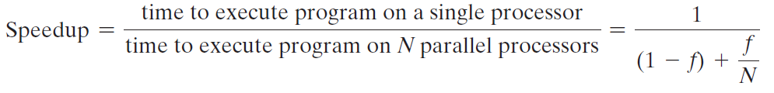
Amdahl’s Law
Identifies performance gains from adding additional cores to an application that has both serial and parallel components.
The law assumes a program in which a fraction (1 - f) of the execution time involves code that is inherently serial, and a fraction f that involves code that is infinitely parallelizable with no scheduling overhead.
This law appears to make the prospect of a multicore organization attractive.

Slide 52
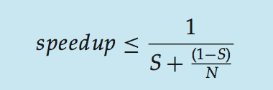
Amdahl’s Law
S is serial portion
N processing cores
That is, if application is 75% parallel / 25% serial, moving from 1 to 2 cores results in speedup of 1.6 times
As N approaches infinity, speedup approaches 1 / S
Serial portion of an application has disproportionate effect on performance gained by adding additional cores

Slide 53
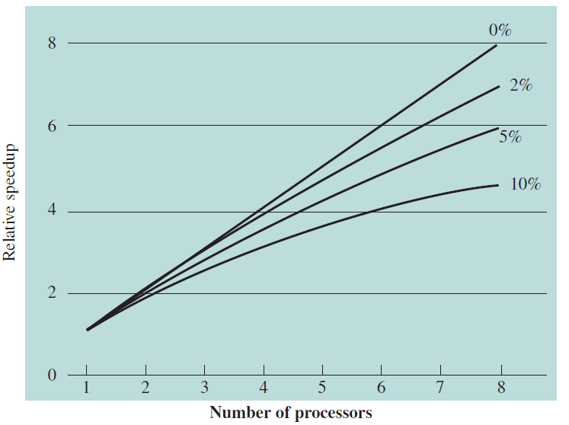
Speedup with 0%, 2%, 5%, and 10% sequential portions

Slide 54
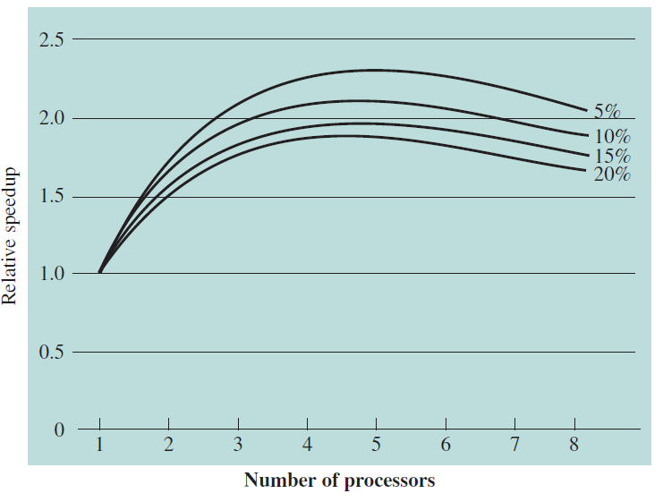
Speedup with overheads

Slide 55
User Threads and Kernel Threads
User threads - management done by user-level threads library
Three primary thread libraries:
POSIX Pthreads
Windows threads
Java threads
Kernel threads - Supported by the Kernel
Examples – virtually all general purpose operating systems, including:
Windows
Solaris
Linux
Tru64 UNIX
Mac OS X

Slide 56
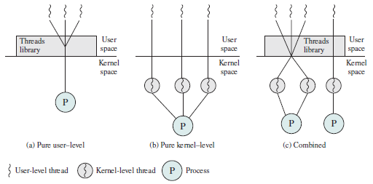
User-Level and Kernel-Level Threads

Slide 57
Threads in user space-the good
Thread table contains information about threads (program counter, stack pointer...) so that run time system can manage them
If thread blocks, run time system stores thread information in table and finds new thread to run.
State save and scheduling are invoked faster than kernel call (no trap, no cache flush)
Tanenbaum, Modern Operating Systems 3 e, (c) 2008 Prentice-Hall, Inc. All rights reserved. 0-13-6006639

Slide 58
Threads in user space-the bad
Can’t let thread execute system call which blocks because it will block all of the other threads
No elegant solution
Manage some how system library to avoid blocking calls
Could use select system calls-in some versions of Unix which do same thing
Threads don’t voluntarily give up CPU
Could interrupt periodically to give control to run time system
Overhead of this solution is a problem
Tanenbaum, Modern Operating Systems 3 e, (c) 2008 Prentice-Hall, Inc. All rights reserved. 0-13-6006639

Slide 59
Threads in kernel space-the good
Kernel keeps same thread table as user table
If thread blocks, kernel just picks another one
Not necessarily from same process!
Tanenbaum, Modern Operating Systems 3 e, (c) 2008 Prentice-Hall, Inc. All rights reserved. 0-13-6006639

Slide 60
Threads in kernel space-the bad
Expensive to manage the threads in the kernel and takes valuable kernel space
How do we get the advantages of both approaches, without the disadvantages?
Tanenbaum, Modern Operating Systems 3 e, (c) 2008 Prentice-Hall, Inc. All rights reserved. 0-13-6006639

Slide 61
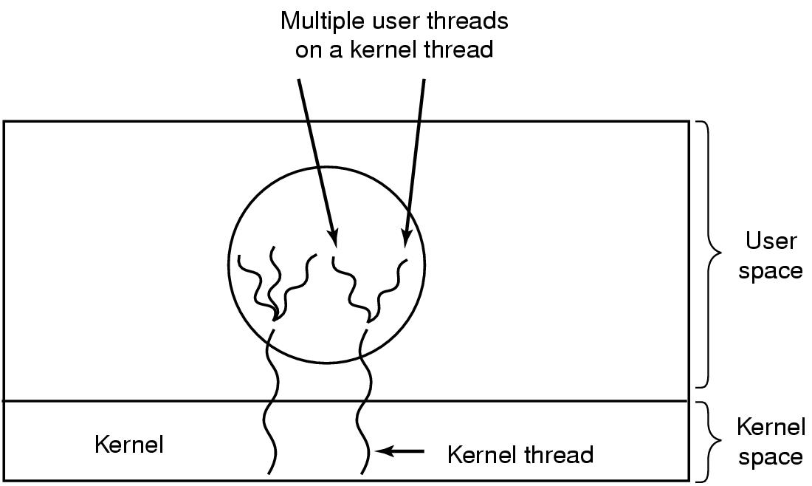
Hybrid approach
Multiplex user-level threads onto kernel level threads
Tanenbaum, Modern Operating Systems 3 e, (c) 2008 Prentice-Hall, Inc. All rights reserved. 0-13-6006639

Slide 62
Hybrid
Kernel is aware of kernel threads only
User level threads are scheduled, created, destroyed independently of kernel thread
Programmer determines how many user level and how many kernel level threads to use
Tanenbaum, Modern Operating Systems 3 e, (c) 2008 Prentice-Hall, Inc. All rights reserved. 0-13-6006639

Slide 63
Multithreading Models
Many-to-One
One-to-One
Many-to-Many

Slide 64
Many-to-One
Many user-level threads mapped to single kernel thread
One thread blocking causes all to block
Multiple threads may not run in parallel on multicore system because only one may be in kernel at a time
Few systems currently use this model
Examples:
Solaris Green Threads
GNU Portable Threads

Slide 65
One-to-One
Each user-level thread maps to kernel thread
Creating a user-level thread creates a kernel thread
More concurrency than many-to-one
Number of threads per process sometimes restricted due to overhead
Examples
Windows
Linux
Solaris 9 and later

Slide 66
Many-to-Many Model
Allows many user level threads to be mapped to many kernel threads
Allows the operating system to create a sufficient number of kernel threads
Solaris prior to version 9
Windows with the ThreadFiber package

Slide 67
Thread Libraries
Thread library provides programmer with API for creating and managing threads
Two primary ways of implementing
Library entirely in user space
Kernel-level library supported by the OS

Slide 68
Pthreads
May be provided either as user-level or kernel-level
A POSIX standard (IEEE 1003.1c) API for thread creation and synchronization
Specification, not implementation
API specifies behavior of the thread library, implementation is up to development of the library
Common in UNIX operating systems (Solaris, Linux, Mac OS X)

Slide 69
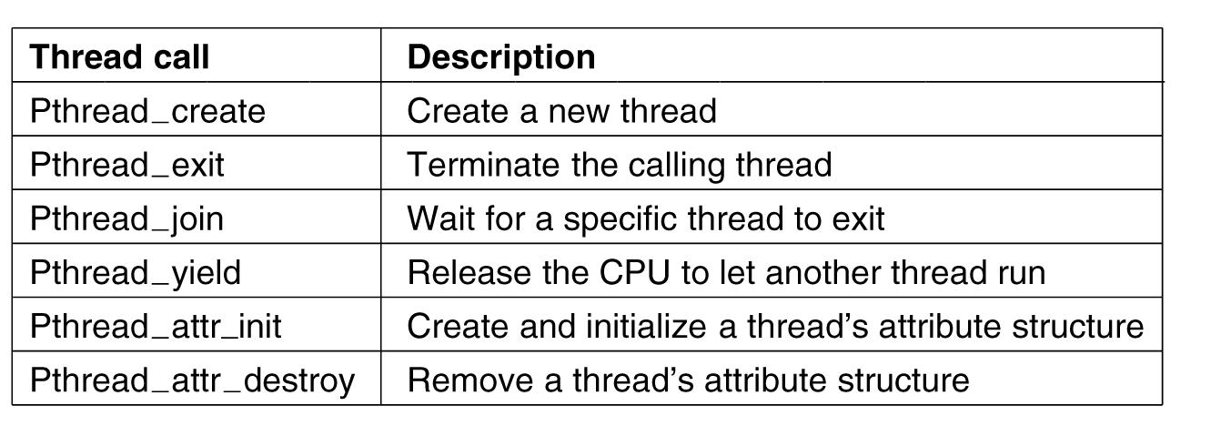
POSIX Threads (Pthreads)
Pthreads are IEEE Unix standard library calls
Tanenbaum, Modern Operating Systems 3 e, (c) 2008 Prentice-Hall, Inc. All rights reserved. 0-13-6006639

Slide 70
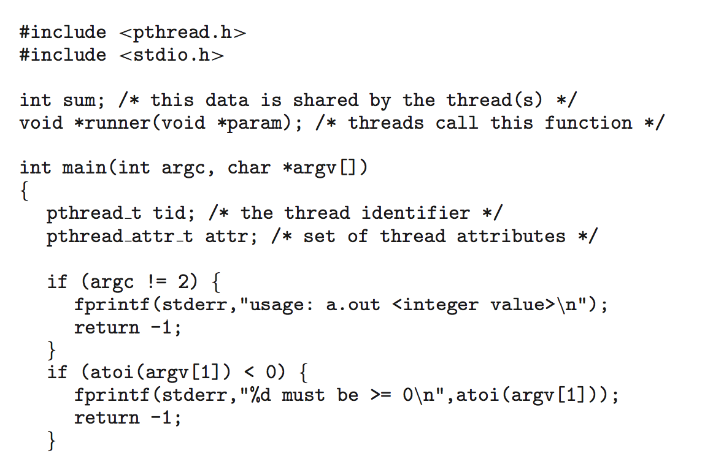
Pthreads Example

Slide 71
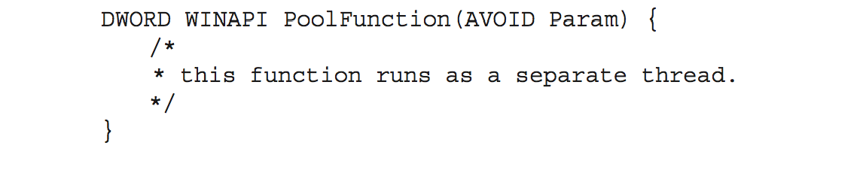
Thread Pools
Create a number of threads in a pool where they await work
Advantages:
Usually slightly faster to service a request with an existing thread than create a new thread
Allows the number of threads in the application(s) to be bound to the size of the pool
Separating task to be performed from mechanics of creating task allows different strategies for running task
i.e.Tasks could be scheduled to run periodically
Windows API supports thread pools:

Slide 72
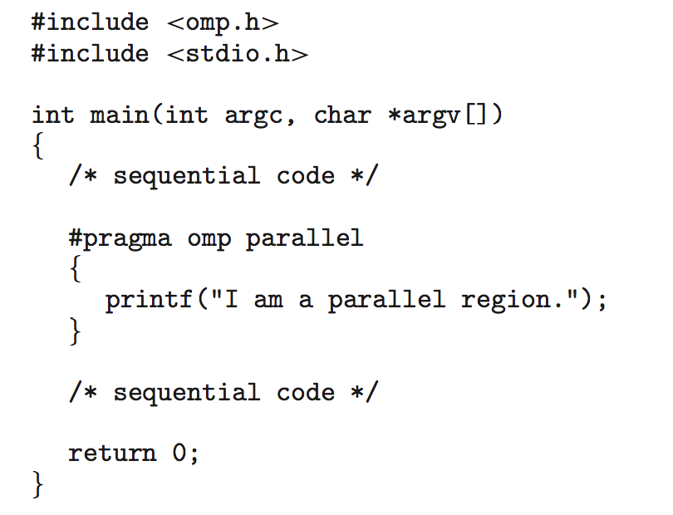
OpenMP
Set of compiler directives and an API for C, C++, FORTRAN
Provides support for parallel programming in shared-memory environments
Identifies parallel regions – blocks of code that can run in parallel
#pragma omp parallel
Create as many threads as there are cores
#pragma omp parallel for for(i=0;i<N;i++) {
c[i] = a[i] + b[i];
}
Run for loop in parallel

Slide 73
Grand Central Dispatch
Apple technology for Mac OS X and iOS operating systems
Extensions to C, C++ languages, API, and run-time library
Allows identification of parallel sections
Manages most of the details of threading
Block is in “^{ }” - ˆ{printf("I am a block"); }
Blocks placed in dispatch queue
Assigned to available thread in thread pool when removed from queue

Slide 74
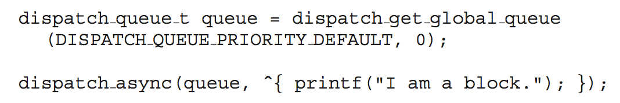
Grand Central Dispatch
Two types of dispatch queues:
Serial – blocks removed in FIFO order, queue is per process, called main queue
Programmers can create additional serial queues within program
Concurrent – removed in FIFO order but several may be removed at a time
Three system wide queues with priorities low, default, high

Slide 75
Threading Issues
Semantics of fork() and exec() system calls
Signal handling
Synchronous and asynchronous
Thread cancellation of target thread
Asynchronous or deferred
Thread-local storage
Scheduler Activations

Slide 76
Semantics of fork() and exec()
Does fork()duplicate only the calling thread or all threads from the parent?
Some UNIXes have two versions of fork
exec() usually works as normal – replace the running process including all threads

Slide 77
Signal Handling
Signals are used in UNIX systems to notify a process that a particular event has occurred.
A signal handler is used to process signals
Signal is generated by particular event
Signal is delivered to a process
Signal is handled by one of two signal handlers:
default
user-defined
Every signal has default handler that kernel runs when handling signal
User-defined signal handler can override default
For single-threaded, signal delivered to process

Slide 78
Signal Handling (Cont.)
Where should a signal be delivered for multi-threaded?
Deliver the signal to the thread to which the signal applies
Deliver the signal to every thread in the process
Deliver the signal to certain threads in the process
Assign a specific thread to receive all signals for the process

Slide 79
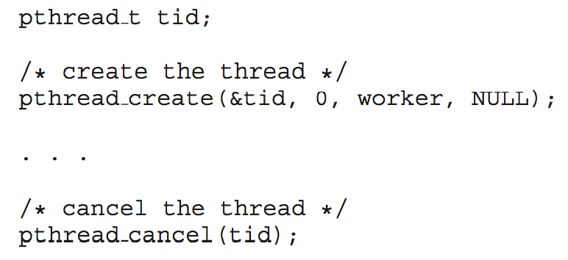
Thread Cancellation
Terminating a thread before it has finished
Thread to be canceled is target thread
Two general approaches:
Asynchronous cancellation terminates the target thread immediately
Deferred cancellation allows the target thread to periodically check if it should be cancelled
Pthread code to create and cancel a thread:

Slide 80
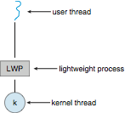
Scheduler Activations
Both M:M and Two-level models require communication to maintain the appropriate number of kernel threads allocated to the application
Typically use an intermediate data structure between user and kernel threads – lightweight process (LWP)
Appears to be a virtual processor on which process can schedule user thread to run
Each LWP attached to kernel thread
How many LWPs to create?
Scheduler activations provide upcalls - a communication mechanism from the kernel to the upcall handler in the thread library
This communication allows an application to maintain the correct number kernel threads

Slide 81
Creating multiple threads
Asynchronous threading
Once the parent creates a child thread, the parent resumes its execution
Parent and child run concurrently
Each thread runs independently of other
Little data sharing between the independent threads
Used in multithreaded servers
Synchronous threading
Occurs when parent creates children and then waits for all of its children to terminate before it resumes
Called fork-join strategy
The created threads perform work concurrently
Parent cannot continue until each thread completes its work
It involves significant data sharing among threads

Slide 82
Linux Threads
Linux refers to them as tasks rather than threads
Thread creation is done through clone() system call
clone() allows a child task to share the address space of the parent task (process)
Flags control behavior
struct task_struct points to process data structures (shared or unique)

Slide 83
Scheduler Activations
Both M:M and Two-level models require communication to maintain the appropriate number of kernel threads allocated to the application
Typically use an intermediate data structure between user and kernel threads – lightweight process (LWP)
To the user-thread library, LWP appears to be a virtual processor on which process can schedule user thread to run
Each LWP attached to a kernel thread
It is kernel threads that the OS schedules to run on physical processors
If a kernel thread blocks (e.g. waiting for I/O), the LWP blocks and the user-level thread attached to the LWP also blocks
Typically, an LWP is required for each concurrent blocking system call

Slide 84
Thread Scheduling
Distinction between user-level and kernel-level threads
On operating systems that support them, it is kernel-level threads and not processes that are being scheduled by the operating system
User level threads are managed by a thread library, that kernel may be unaware of
To run on a CPU, user-level threads must be ultimately mapped to an associated kernel-level thread e.g. using LWP

Slide 85
Thread Scheduling
When threads supported, threads are scheduled, not processes
Many-to-one and many-to-many models, thread library schedules user-level threads to run on LWP
Known as process-contention scope (PCS) since scheduling competition is within the process
Typically done via priority set by programmer
Deciding which kernel thread to schedule onto available CPU is system-contention scope (SCS) – competition among all threads in system

Slide 86
Thread Scheduling
PCS is done according to priority
Scheduler selects the runnable thread with the highest priority to run
User level thread priorities are set by the programmer and are not adjusted by thread library
Some thread libraries may allow the programmer to change the priority of a thread.
PCS will preempt the thread currently running if a higher priority thread arrives
There is no guarantee of time slice among threads of equal priority

Slide 87
Pthread Scheduling
POSIX Pthread API allows specifying either PCS or SCS during thread creation
Contention scope values
PTHREAD_SCOPE_PROCESS schedules threads using PCS scheduling
PTHREAD_SCOPE_SYSTEM schedules threads using SCS scheduling
Can be limited by OS
Linux and MacOSX only allow PTHREAD_SCOPE_SYSTEM

Slide 88
Multiple-Processor Scheduling
CPU scheduling more complex when multiple CPUs are available
Homogeneous processors within a multiprocessor
One approach to CPU scheduling in a multiprocessor system has all scheduling decisions, I/O processing, and other system activities handled by a single processor—the master server.
The other processors execute only user code.
Asymmetric multiprocessing – only one processor accesses the system data structures, alleviating the need for data sharing

Slide 89
Multiple-Processor Scheduling
Symmetric multiprocessing (SMP) – each processor is self-scheduling
All processes in common ready queue, or each has its own private queue of ready processes
CPU scheduling proceeds by having the scheduler for each processor examine the ready queue and select a process to execute.
All modern operating systems support SMP
Processor affinity – process has affinity for processor on which it is currently running
soft affinity
hard affinity
Variations including processor sets

Slide 90
NUMA and CPU Scheduling
If the operating system’s CPU scheduler and memory-placement algorithms are NUMA-aware and work together, then a thread that has been scheduled onto a particular CPU can be allocated memory closest to where the CPU resides, thus providing the thread the fastest possible memory access.
Load balancing often counteracts the benefits of processor affinity.
That is, the benefit of keeping a thread running on the same processor is that the thread can take advantage of its data being in that processor’s cache memory.
Balancing loads by moving a thread from one processor to another removes this benefit.

Slide 91
Multiple-Processor Scheduling – Load Balancing
If SMP, need to keep all CPUs loaded for efficiency
Load balancing attempts to keep workload evenly distributed
Push migration – periodic task checks load on each processor, and if found pushes task from overloaded CPU to other CPUs
Pull migration – idle processors pulls waiting task from busy processor

Slide 92
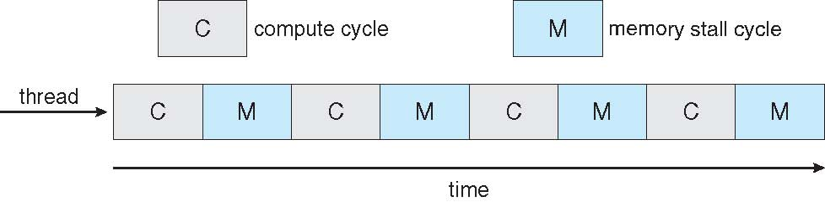
Multithreaded Multicore System
In a multicore processor each core maintains its architectural state and thus appears to the operating system to be a separate physical processor.
SMP systems that use multicore processors are faster and consume less power than systems in which each processor has its own physical chip.
Problem of memory stall
In this scenario, the processor can spend up to 50 percent of its time waiting for data to become available from memory.

Slide 93
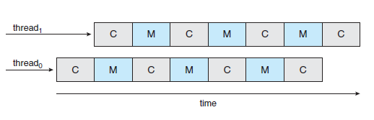
Multithreaded Multicore System
To remedy memory stall situation, many hardware designs implement multithreaded processor cores in which two (or more) hardware threads are assigned to each core.
That way, if one thread stalls while waiting for memory, the core can switch to another thread.
From an operating system perspective, each hardware thread maintains its architectural state, such as instruction pointer and register set, and thus appears as a logical CPU that is available to run a software thread.

Slide 94
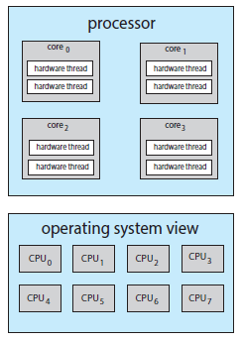
Multithreaded Multicore System
From an operating-system perspective, each hardware thread appears as a logical processor that is available to run a software thread.
Thus, on a dual-threaded, quad core system, eight logical processors are presented to the operating system.
UltraSPARC T3 CPU has sixteen cores per chip and eight hardware threads per core.
From the perspective of the operating system, there appear to be 128 logical processors.

Slide 95
Chip Multithreading
Intel processors use the term hyper-threading (also known as simultaneous multithreading or SMT) to describe assigning multiple hardware threads to a single processing core.
Contemporary Intel processors—such as the i7—support two threads per core, while the Oracle Sparc M7 processor supports eight threads per core, with eight cores per processor, thus providing the operating system with 64 logical CPUs.

Slide 96
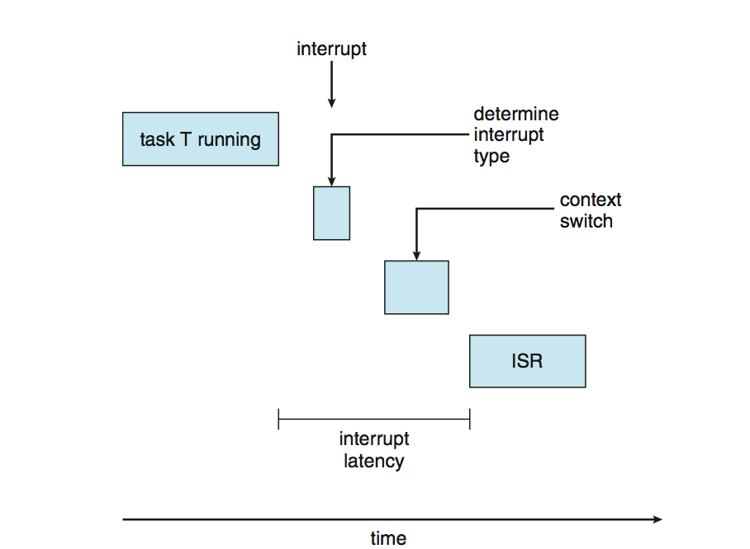
Real-Time CPU Scheduling
Soft real-time systems – no guarantee as to when critical real-time process will be scheduled.
They guarantee only that the process will be given preference over non-critical processes.
Hard real-time systems – task must be serviced by its deadline

Slide 97
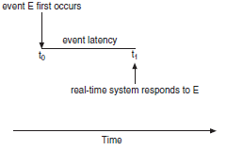
Event latency
Minimize Latency
Event latency is defined as the amount of time that elapses from when an event occurs to when it is serviced
Two types of latencies affect performance
Interrupt latency – time from arrival of interrupt to start of routine that services interrupt
Dispatch latency – time for scheduling dispatcher to take current process off CPU i.e. stop it and switch to another

Slide 98
Real-Time CPU Scheduling (Cont.)
Dispatch latency should be low for preemptive kernels
Conflict phase of dispatch latency has two components:
Preemption of any process running in kernel mode
Release by low-priority process of resources needed by high-priority processes.

Slide 99
Priority-based Scheduling
Most important feature of a real-time operating system is to respond immediately to a real-time process as soon as that process requires the CPU.
For real-time scheduling, scheduler must support preemptive, priority-based scheduling
But only guarantees soft real-time
If the scheduler also supports preemption, a process currently running on the CPU will be preempted if a higher-priority process becomes available to run.

Slide 100
Hard real-time Systems
Hard real-time systems must also provide ability to meet deadlines
Hard real-time systems must further guarantee that real-time tasks will be serviced in accordance with their deadline requirements
Making such guarantees requires additional scheduling features.

Slide 101
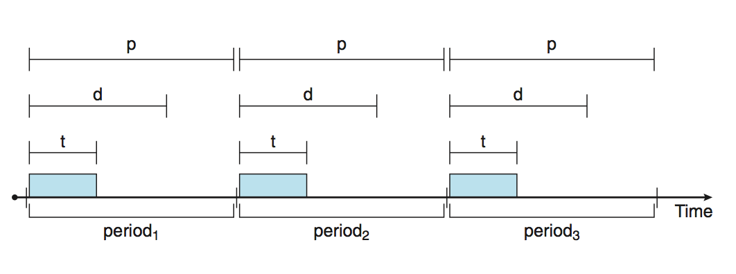
Real-time Priority based Scheduling
Processes have new characteristics:
Processes require the CPU at constant intervals (periods).
Once a periodic process has acquired the CPU, it has a fixed processing time t, a deadline d by which it must be serviced by the CPU, and a period p.
The relationship of the processing time, the deadline, and the period can be expressed as 0 ≤ t ≤ d ≤ p.
Rate of periodic task is 1/p

Slide 102
Real-time Priority based Scheduling
A process may have to announce its deadline requirements to the scheduler.
Then, using an admission-control algorithm, the scheduler does one of two things.
It either admits the process, guaranteeing that the process will complete on time, or rejects the request as impossible if it cannot guarantee that the task will be serviced by its deadline.

Slide 103

Rate Monotonic Scheduling
A priority is assigned based on the inverse of its period
Shorter periods = higher priority;
Longer periods = lower priority
Period p1 = 50, p2 = 100,
Processing time t1 = 20, t2 = 35
The deadline for each process requires that it complete its CPU burst by the start of its next period.
CPU Utilization = the ratio of process P_{i}, its burst to its period—ti∕pi
In the figure, P2 has a higher priority than P1.

Slide 104
Rate Monotonic Scheduling
Assign a higher priority to tasks that require the CPU more often.
Assumption: Processing time of a periodic process is the same for each CPU burst.
That is, every time a process acquires the CPU, the duration of its CPU burst is the same.
In the figure, P2 has a higher priority than P1.
As we can see, P2 starts execution first and completes at time 35. At this point, P1 starts; it completes its CPU burst at time 55.
However, the first deadline for P1 was at time 50, so the scheduler has caused P1 to miss its deadline.

Slide 105
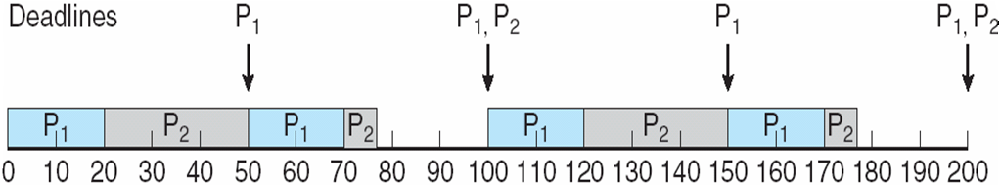
Rate Monotonic Scheduling …
P1 starts first and completes its CPU burst at time 20, thereby meeting its first deadline.
P2 starts running at this point and runs until time 50.
At this time, it is preempted by P1, although it still has 5 milliseconds remaining in its CPU burst.
P1 completes its CPU burst at time 70, at which point the scheduler resumes P2.
P2 completes its CPU burst at time 75, also meeting its first deadline.
The system is idle until time 100, when P1 is scheduled again.

Slide 106
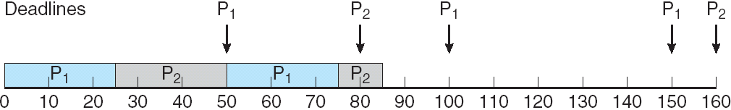
Rate Monotonic Scheduling …
Assume that process P1 has a period of p1 = 50 and a CPU burst of t1 = 25.
For P2, p2 = 80 and t2 = 35.
Rate-monotonic scheduling would assign process P1 a higher priority, as it has the shorter period.
The total CPU utilization of the two processes is (25/50)+(35/80) = 0.94,
6 percent CPU time is available.

Slide 107
Missing Deadlines with Rate Monotonic Scheduling
Rate-monotonic scheduling is considered optimal in that if a set of processes cannot be scheduled by this algorithm, it cannot be scheduled by any other algorithm that assigns static priorities
Limitation: CPU utilization is bounded, and it may not always be possible to fully maximize CPU resources.
The worst-case CPU utilization for scheduling N processes is N(2^{1/N} − 1).

Slide 108
Earliest Deadline First Scheduling (EDF)
Priorities are assigned according to deadlines:
the earlier the deadline, the higher the priority
the later the deadline, the lower the priority
Under the EDF policy, when a process becomes runnable, it must announce its deadline requirements to the system.
Priorities may have to be adjusted to reflect the deadline of the newly runnable process.

Slide 109
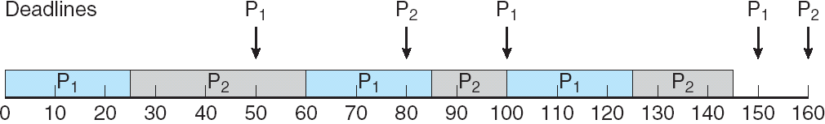
Earliest Deadline First Scheduling (EDF)
Process P1 has the earliest deadline, so its initial priority is higher than that of process P2.
Process P2 begins running at the end of the CPU burst for P1.
EDF scheduling allows process P2 to continue running.
P2 now has a higher priority than P1 because its next deadline (at time 80) is earlier than that of P1 (at time 100).
Thus, both P1 and P2 meet their first deadlines.

Slide 110
Proportional Share Scheduling
T shares are allocated among all processes in the system
An application receives N shares where N < T
This ensures each application will receive N / T of the total processor time
As an example, assume that a total of T = 100 shares is to be divided among three processes, A, B, and C. A is assigned 50 shares, B is assigned 15 shares, and C is assigned 20 shares.
This scheme ensures that A will have 50 percent of total processor time, B will have 15 percent, and C will have 20 percent.

Slide 111
Proportional Share Scheduling
Proportional share schedulers must work in conjunction with an admission-control policy to guarantee that an application receives its allocated shares of time.
An admission-control policy will admit a client requesting a particular number of shares only if sufficient shares are available.

Slide 112
POSIX Real-Time Scheduling
The POSIX.1b standard
API provides functions for managing real-time threads
Defines two scheduling classes for real-time threads:
SCHED_FIFO - threads are scheduled using a FCFS strategy with a FIFO queue. There is no time-slicing for threads of equal priority
SCHED_RR - similar to SCHED_FIFO except time-slicing occurs for threads of equal priority
Defines two functions for getting and setting scheduling policy:
pthread_attr_getsched_policy(pthread_attr_t *attr, int *policy)
pthread_attr_setsched_policy(pthread_attr_t *attr, int policy)

Slide 113
POSIX Real-Time Scheduling API
#include <pthread.h>
#include <stdio.h>
#define NUM_THREADS 5
int main(int argc, char *argv[])
{
int i, policy; pthread_t_tid[NUM_THREADS];
pthread_attr_t attr;
/* get the default attributes */
pthread_attr_init(&attr);
/* get the current scheduling policy */ if (pthread_attr_getschedpolicy(&attr, &policy) != 0)
fprintf(stderr, "Unable to get policy.\n");
else {
if (policy == SCHED_OTHER) printf("SCHED_OTHER\n");
else if (policy == SCHED_RR) printf("SCHED_RR\n");
else if (policy == SCHED_FIFO) printf("SCHED_FIFO\n");
}

Slide 114
POSIX Real-Time Scheduling API (Cont.)
/* set the scheduling policy - FIFO, RR, or OTHER */ if (pthread_attr_setschedpolicy(&attr, SCHED_FIFO) != 0)
fprintf(stderr, "Unable to set policy.\n");
/* create the threads */ for (i = 0; i < NUM_THREADS; i++)
pthread_create(&tid[i],&attr,runner,NULL);
/* now join on each thread */ for (i = 0; i < NUM_THREADS; i++)
pthread_join(tid[i], NULL);
}
/* Each thread will begin control in this function */
void *runner(void *param) {
/* do some work ... */
pthread_exit(0);
}

Slide 115
Queueing Models
On many systems, the processes that are run vary from day to day, so there is no static set of processes (or times) to use for deterministic modeling.
What can be determined, however, is the distribution of CPU and I/O bursts. These distributions can be measured and then approximated or simply estimated. The result is a mathematical formula describing the probability of a particular CPU burst.

Slide 116
Queueing Models
Describes the arrival of processes, and CPU and I/O bursts probabilistically
Commonly exponential, and described by mean
Computes average throughput, utilization, waiting time, etc
Computer system described as network of servers, each with queue of waiting processes
Knowing arrival rates and service rates (queueing-network analysis)
Computes utilization, average queue length, average wait time, etc.

Slide 117
Little’s Formula
n = average queue length
W = average waiting time in queue
λ = average arrival rate into queue
Little’s law – in steady state, processes leaving queue must equal processes arriving, thus: n = λ x W
Valid for any scheduling algorithm and arrival distribution
For example, if on average 7 processes arrive per second, and normally 14 processes in queue, then average wait time per process = 2 seconds

Slide 118
Simulations
Queueing models limited
Simulations more accurate
Programmed model of computer system
Clock is a variable
Gather statistics indicating algorithm performance
Data to drive simulation gathered via
Random number generator according to probabilities
Distributions defined mathematically or empirically
Trace tapes record sequences of real events in real systems

Slide 119
Implementation
Even simulations have limited accuracy
Just implement new scheduler and test in real systems
High cost, high risk
Environments vary
Most flexible schedulers can be modified per-site or per-system
Or APIs to modify priorities
But again environments vary

